Slide 1
Git Hub Branch/Collaboration

Slide 2
Why Branches Matter in Collaboration
Main (or master) branch = production-ready code (should always be deployable)
You never code directly on main in a team
Branches let multiple people work simultaneously without conflicts
Enable code review, discussion, and safe experimentation
Core question: "How do we let 5–50 people touch the same codebase/ or file every day?"

Slide 3
Core GitHub Branch Concepts
main (or master) → stable, production branch
Feature / topic branches → short-lived, purpose-specific

Slide 4
GitHub Flow – The Modern Standard (Step-by-step)
Create branch from main git checkout -b feature/payment-stripe-integration
Work + commit often (small commits!)
Push branch regularly git push -u origin feature/payment-stripe-integration
Open Pull Request (PR) early (even if not finished)
Discuss + review code in the PR
Run CI checks (tests, lint, security scan)
Merge (usually squash & merge or rebase & merge)
Delete branch (GitHub can do it automatically)

Slide 5
Pull Requests – The Heart of Collaboration
Must-have PR settings (branch protection rules):
Require at least 1–2 approvals
Require status checks to pass (CI)
Dismiss stale approvals on new pushes
Do not allow direct pushes to main
(Optional) require linear history or rebase
Golden rules for great PRs:
Small PRs (< 400 lines ideal)
Clear title: "Add user email verification with OTP"
Good description + screenshots
Link to issue/ticket
Self-review before asking others

Slide 6
Example :student.csv
Name | Age | DS Score | IT Score | Comm Skill | French
Alice | 25
Bob | 30
Charlie | 28
Kofi | 40
Obeng | 22
Emma | 43
Godwin | 34

Slide 7
Example :student.csv
use the information to take me through the collaboration again, step by step:
Kofi is doing the Name and Age ,
Ama is working on DS Score and IT Score and
Kojo is working on Comm Skills and French columns

Slide 8
Example :student.csv
Roles (each person owns completely different columns):
Kofi → fills Name + Age (he has the list)
Ama → fills DS Score + IT Score
Kojo → fills Comm Skills + French
All three work at the same time on different columns → Git merges everything perfectly with zero manual conflict.

Slide 9
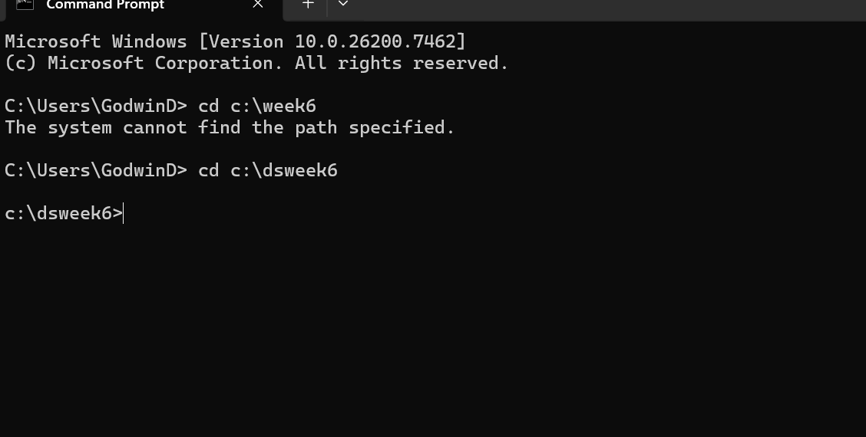
In the right local repository
Use : cd c:\dsweek6

Slide 10
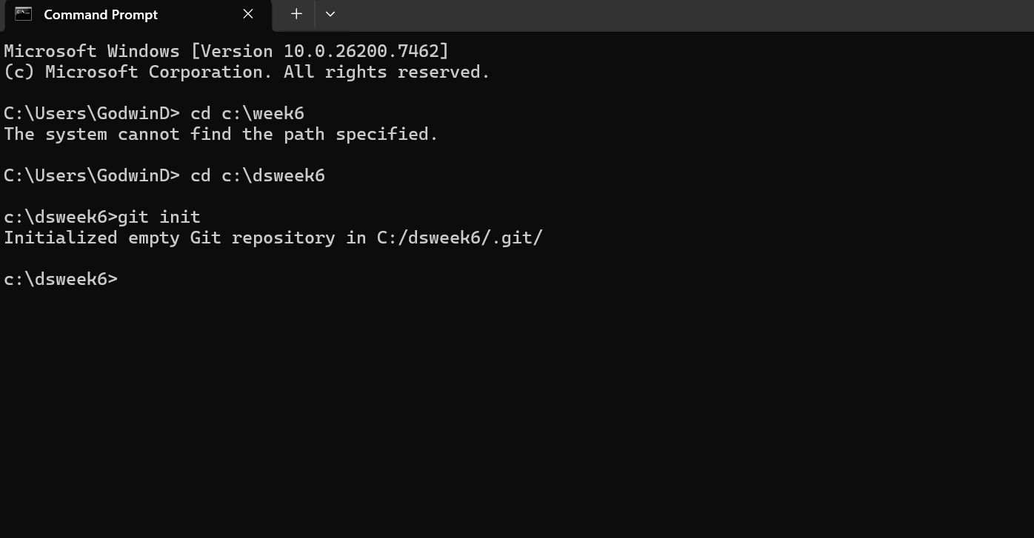
Initiating Git (local)Repositories
Use: git init

Slide 11
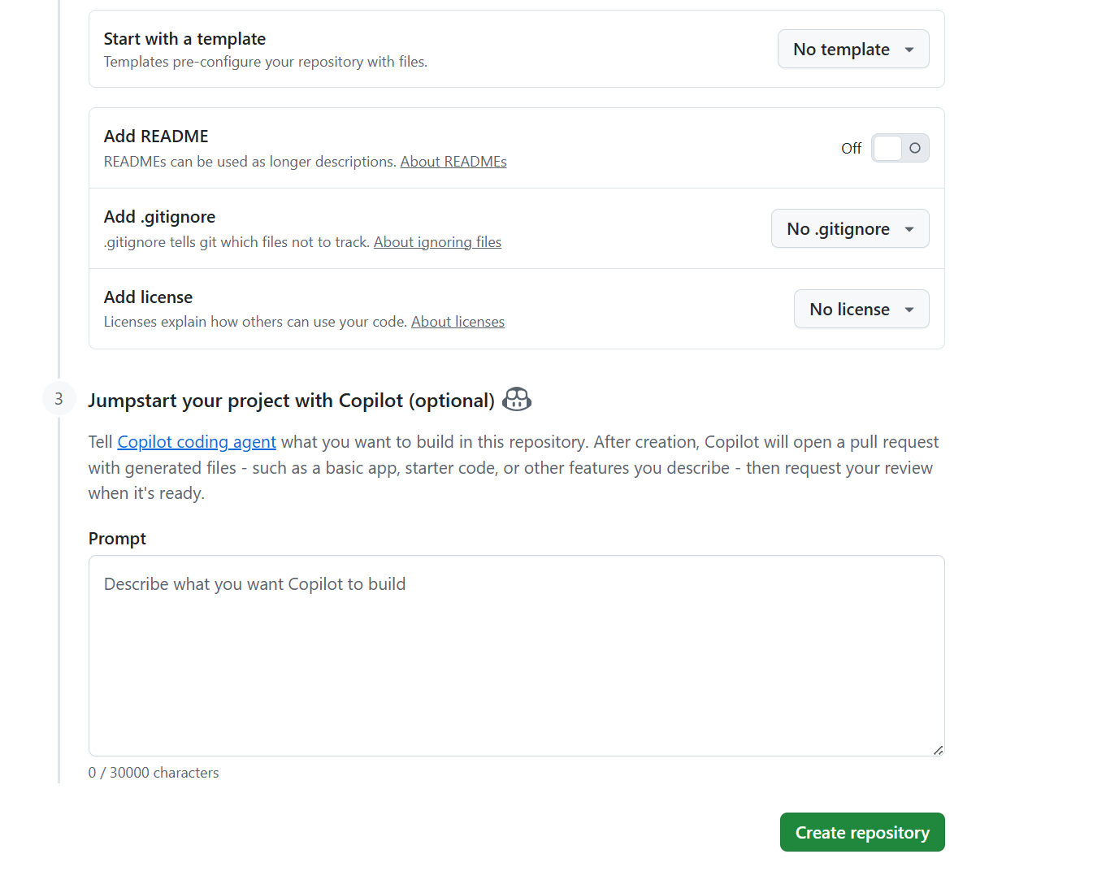
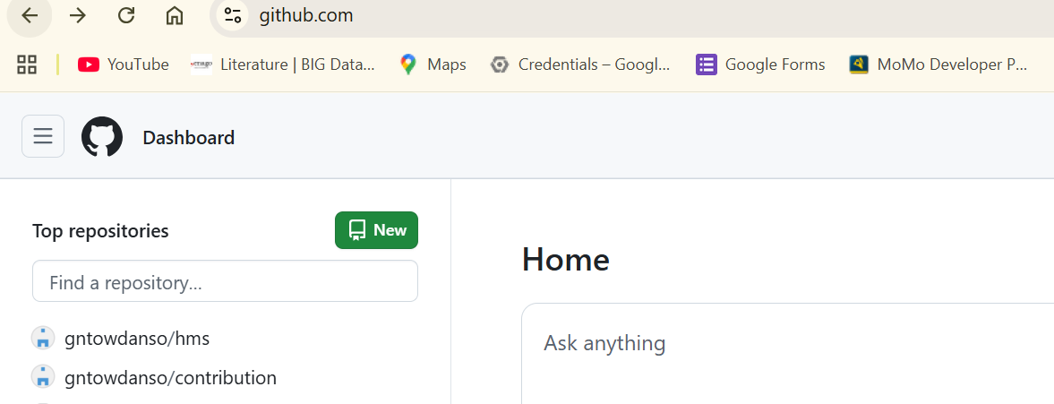
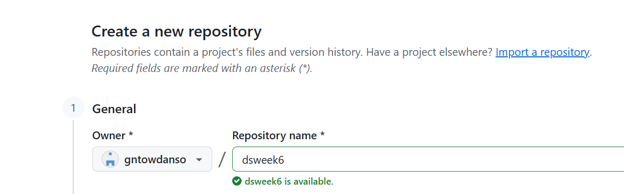






Create git hub repository

Slide 12
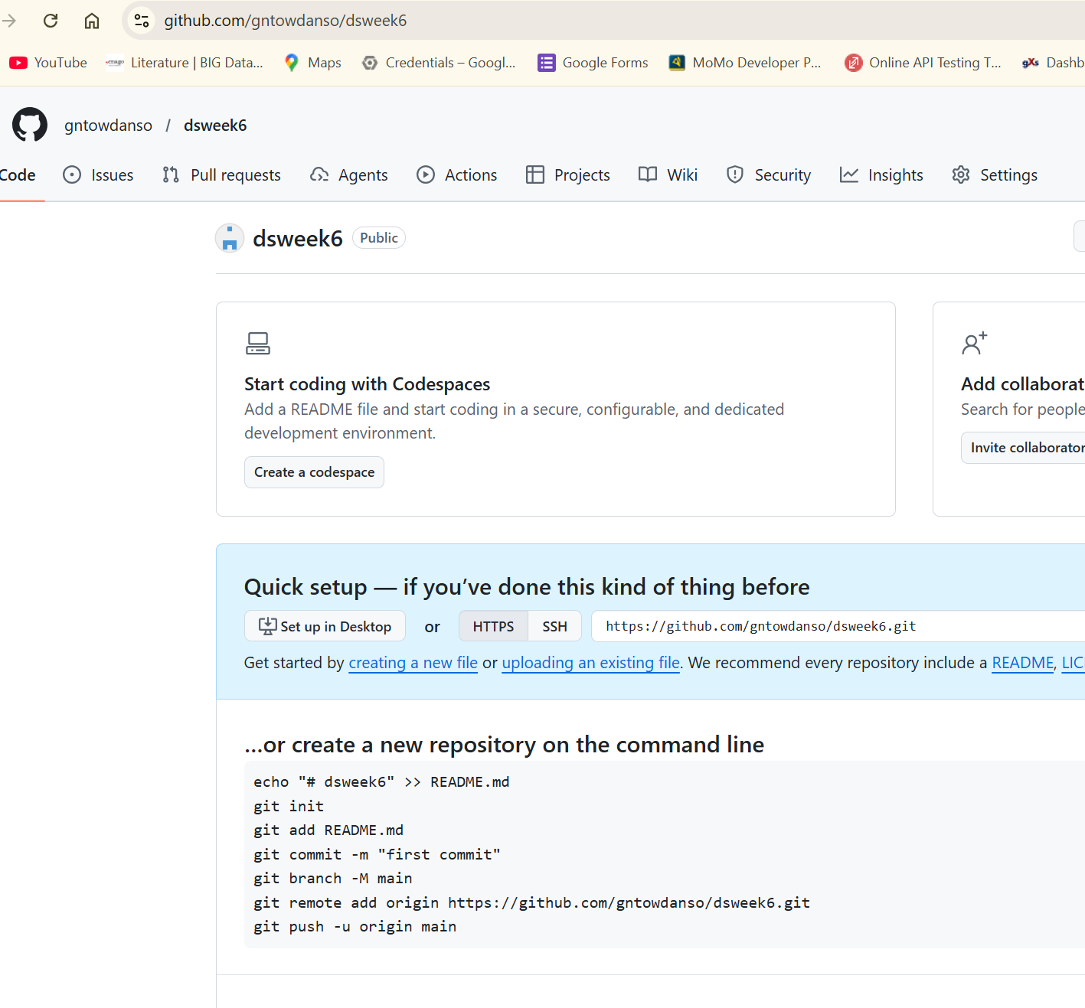
Create git hub repository

Slide 13
Create git hub repository:Copy the codes note the slight change of git add .
echo "# dsweek6" >> README.md
git init
git add .
git commit -m "first commit"
git branch -M main
git remote add origin https://github.com/gntowdanso/dsweek6.git
git push -u origin main

Slide 14
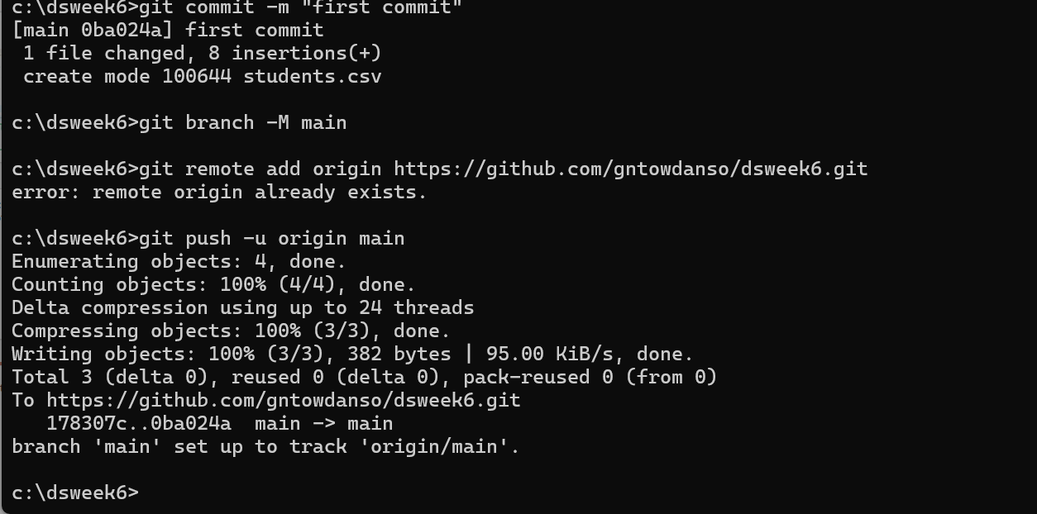
Paste at the local repository

Slide 15
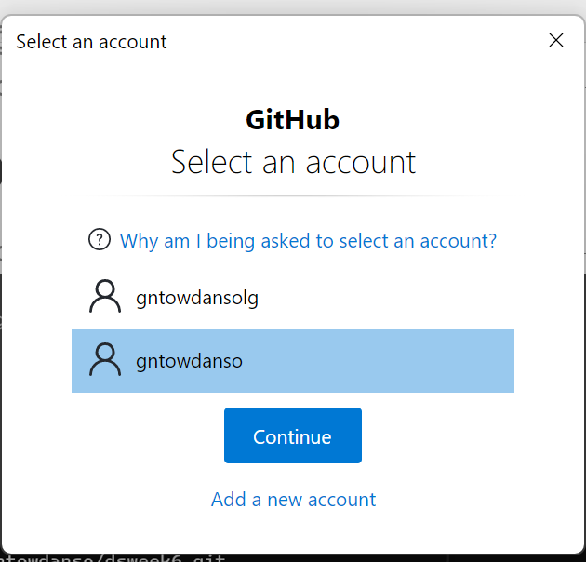
Accept the Authorization and click:continue

Slide 16
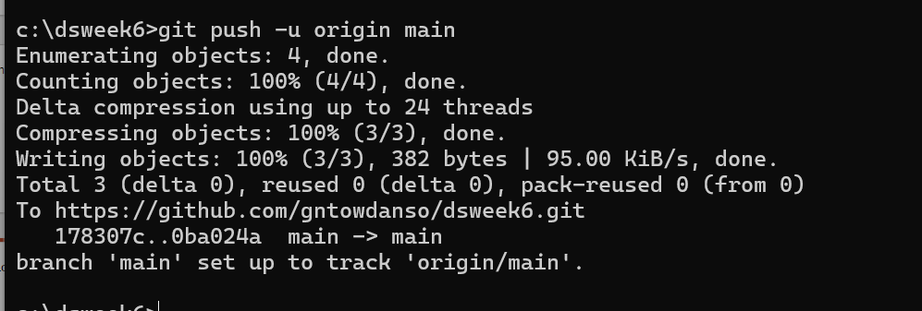
Local repository should look like below

Slide 17
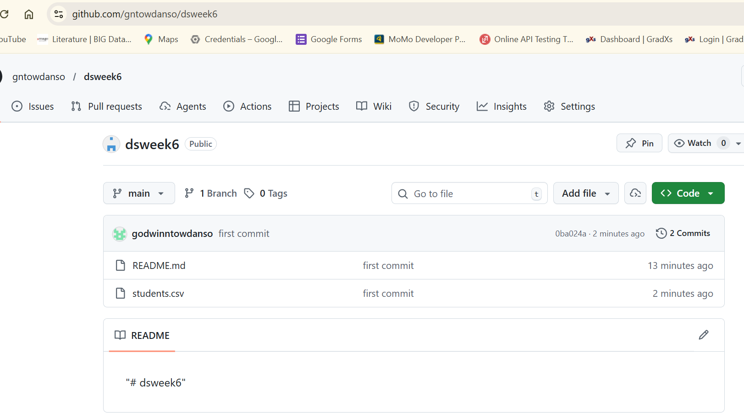
Online(Git hub) repository should like below

Slide 18
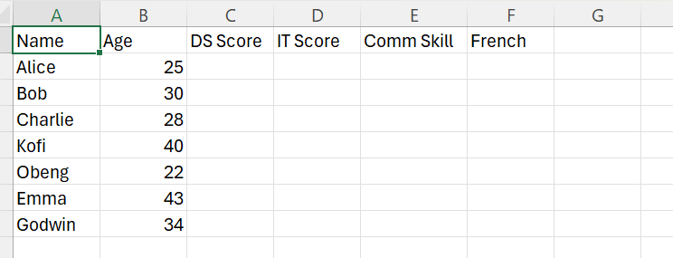
Git Collaboration

Slide 19
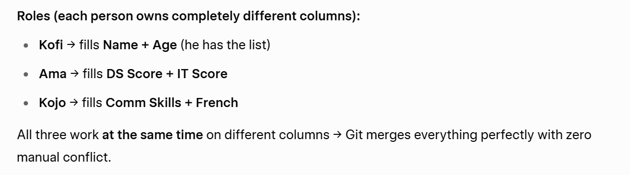
Git Collaboration

Slide 20
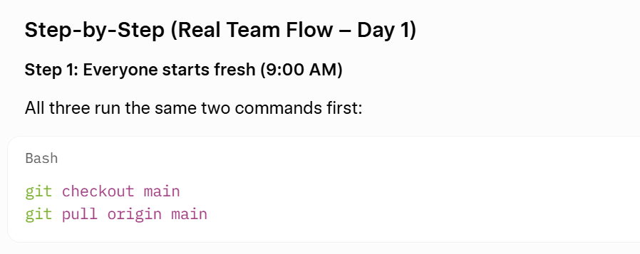
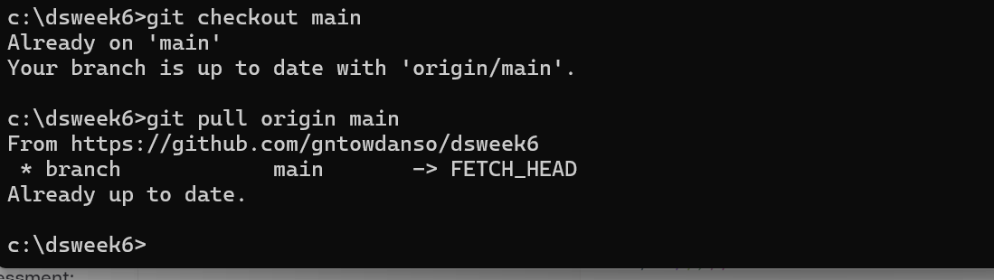
Git Collaboration

Slide 21
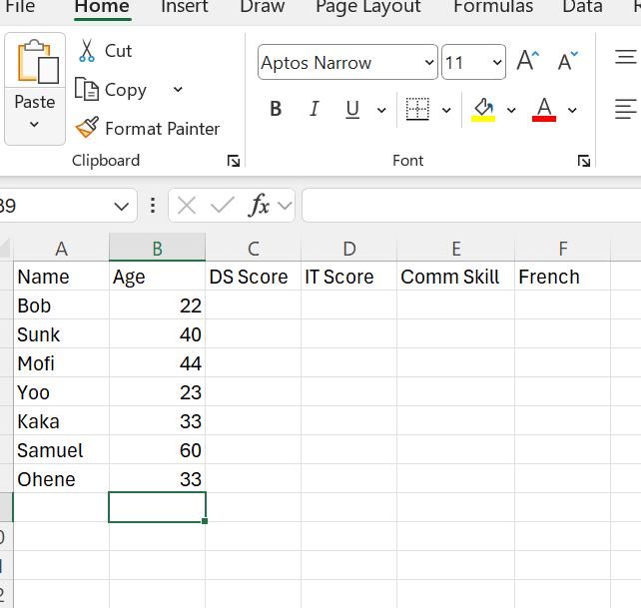
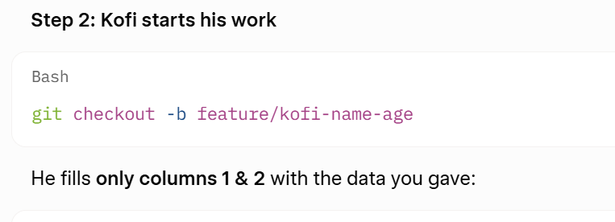
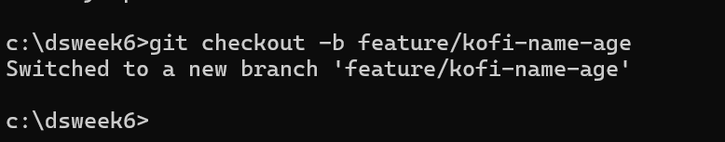
Git Collaboration

Slide 22
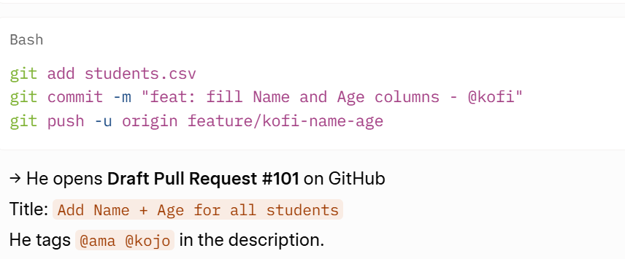
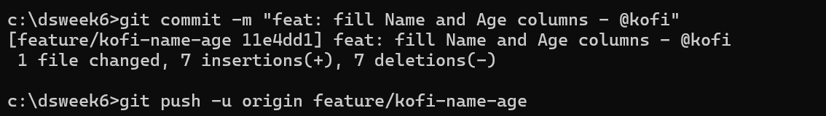
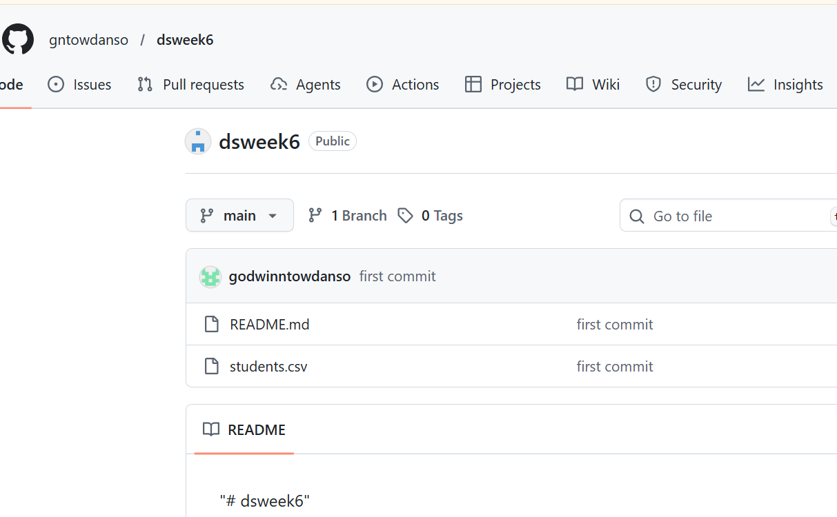
Kofi commit the changes

Slide 23
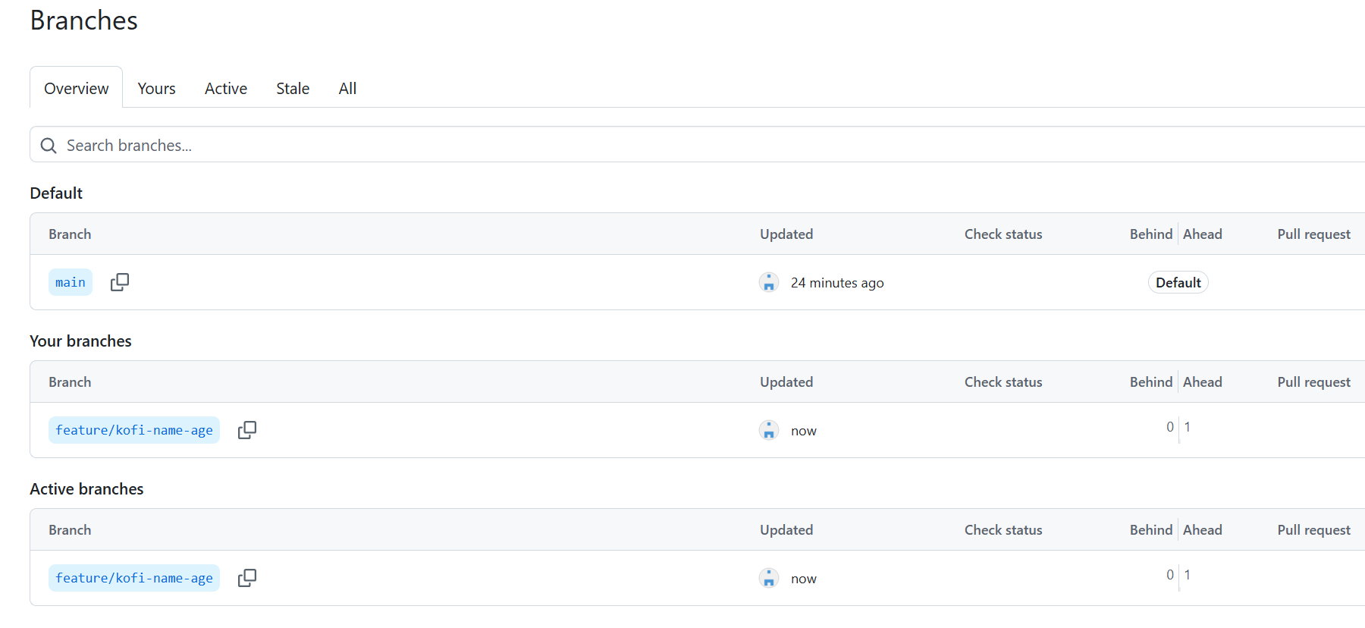
Kofi commit the changes

Slide 24
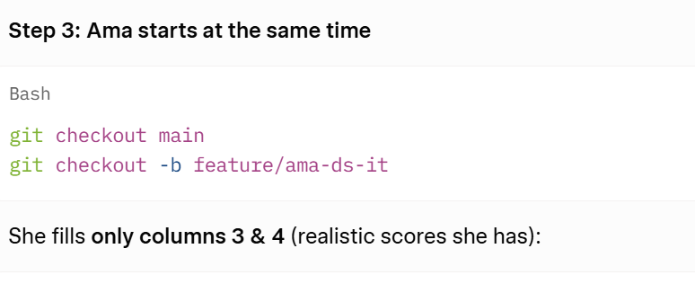
Ama start her own task

Slide 25
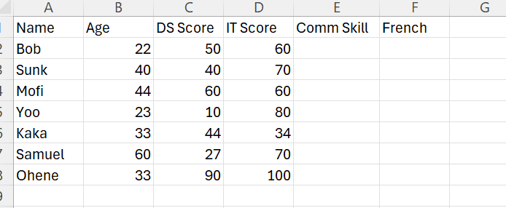
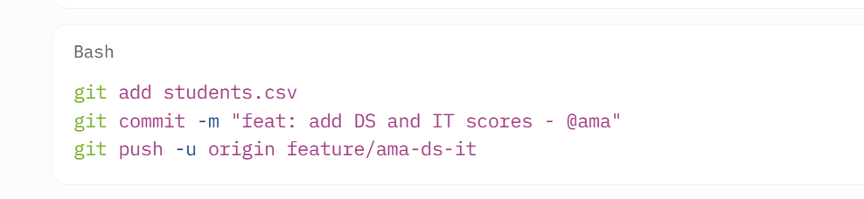
Ama start her complete

Slide 26
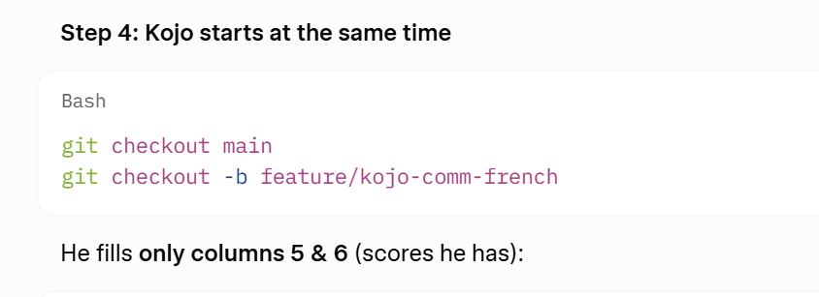
Kojo Start

Slide 27
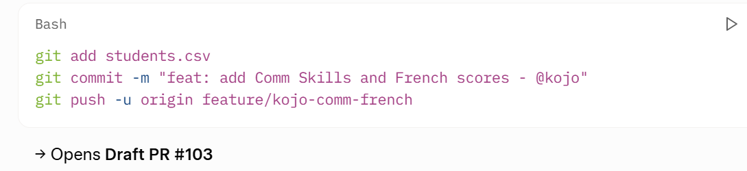
Kojo Complete
Name | Age | DS Score | IT Score | Comm Skill | French
Bob | 22 | 50 | 60 | 66 | 22
Sunk | 40 | 40 | 70 | 45 | 77
Mofi | 44 | 60 | 60 | 24 | 55
Yoo | 23 | 10 | 80 | 33 | 33
Kaka | 33 | 44 | 34 | 55 | 23
Samuel | 60 | 27 | 70 | 77 | 55
Ohene | 33 | 90 | 100 | 90 | 77

Slide 28
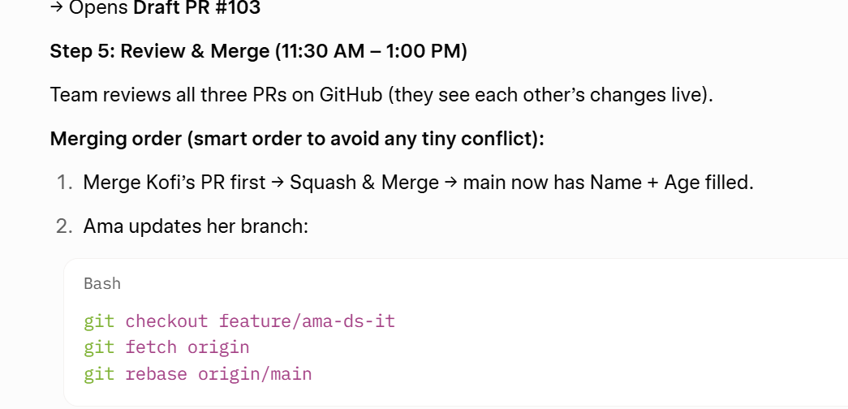
Merging the files

Slide 29
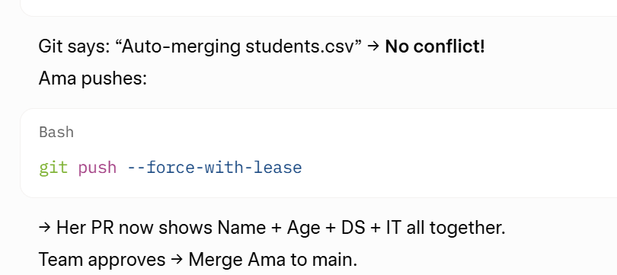
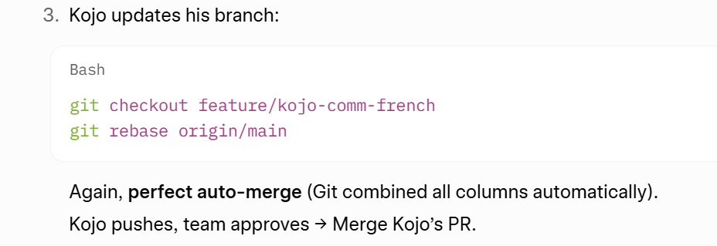
Merging the files

Slide 30
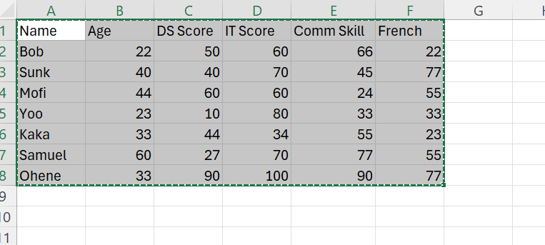
final
All worked Smoothly
Each person edited different columns → Git treats them as non-conflicting changes
Rebase automatically stitched everything together
No one waited for anyone else
All work happened in parallel
Full visibility & approval via Pull Requests
Main stays clean and always up-to-date

